Slide 1


PUTTING CONSISTENCY BACK INTO EVENTUAL CONSISTENCY
Valter Balegas, Sérgio Duarte, Carla Ferreira,
Rodrigo Rodrigues, Nuno Preguiça
NOVA LINCS / U. Nova de Lisboa
Mahsa Najafzadeh, Marc Shapiro
INRIA, LIP6
Notes:
Não esquecer de dar a noçao de que Explicit consistency pode ser implmenrado com ou sem coordenação.
Dar enfase que os mecânismos de reservas fazem-no sem utilizar coordenação no caso geral.

Slide 2
INTERNET SERVICES NOWADAYS
Services operate on a global scale.
An unprecedented number of people are using internet services.
Notes:
Nowadays most notorious web applications operate on an a global scale. From productivity tools to Social Networks more and more people depend on internet services in their daily life.

Slide 3





GEO-REPLICATION
150 ms
SYNC
DC2
DC1
20 ms
20 ms
Notes:
Geo replication is an attractive deployment as it helps to achieve both goals.
Provide low latency to nearby clients
But since replication takes time, these system operate under relaxed forms of consistency

Slide 4
GEO-REPLICATION
DC2
DC1
Notes:
Operating under such weak consistency guarantees can harm correctness properties of applications.
Consider the example of a Game application
Dar enfase que nao se sincroniza entre data-centers À medida que se simula a execução das operações. Dizer que é Eventual.

Slide 5
GEO-REPLICATION
DC2
DC1
Player
Sonic
Pac-man
Mario
Tournament
A
B
Player
Sonic
Pac-man
Mario
Tournament
A
B
Notes:
Não esquecer de usar os mesmos termos consistentemente.
Explicar cada uma das operações.
E a propriedade que se quer manter.
Não falar de invariantes!

Slide 6
GEO-REPLICATION
DC2
DC1
enroll(Pac-man, A)
Player
Sonic
Pac-man
Mario
Tournament
A
B
Player
Sonic
Pac-man
Mario
Tournament
A
B

Slide 7
GEO-REPLICATION
DC2
DC1
enroll(Mario, A)
Player
Sonic
Pac-man
Mario
Tournament
A
B
Player
Sonic
Pac-man
Mario
Tournament
A
B

Slide 8
GEO-REPLICATION
DC2
DC1
removeTournament(A)
Player
Sonic
Pac-man
Mario
Tournament
A
B
Player
Sonic
Pac-man
Mario
Tournament
A
B

Slide 9
GEO-REPLICATION
DC2
DC1
removeTournament(A)
Player
Sonic
Pac-man
Mario
Tournament
A
B
Player
Sonic
Pac-man
Mario
Tournament
B

Slide 10
GEO-REPLICATION
SYNC
DC2
DC1
Player
Sonic
Pac-man
Mario
Tournament
A
B
Player
Sonic
Pac-man
Mario
Tournament
B
Notes:
Propagate the effects!

Slide 11
GEO-REPLICATION
DC2
DC1
Mario is enrolled in tournament that was concurrently removed.
Player
Sonic
Pac-man
Mario
Tournament
B
Player
Sonic
Pac-man
Mario
Tournament
B
Notes:
Operations must be coordinated to maintain consistencys

Slide 12
STRONG CONSISTENCY
enroll(Mario, A)
DC1
SYNC
SYNC
SYNC
DC2
enroll(Pac-man, A)
removeTournament(A)
Ordering of operations:
enroll(Pac-man, A)
enroll(Mario, A)
removeTournament(A)
Notes:
As I’ve shown in the previous picture, when we coordinate between data-centers the latency for operations is high and that is bad for the users experience.
Nao esquecer de referir o traço!

Slide 13
IS COORDINATION NEEDED?
enroll(Mario, A)
Local operation
Low latency
☺
DC1
SYNC
DC2
enroll(Pac-man, A)
removeTournament(A)
Ordering of operations:
enroll(Mario, A)
removeTournament(A)
enroll(Pac-man, A)
Notes:
When we execute the remove we want to make sure we observe previous enrolls

Slide 14
OUTLINE
Background
Explicit Consistency
Indigo
Evaluation
Conclusion
Notes:
taking their semantic into account.
In the rest of this presentation we present Explicit Consistency, a new consistency model designed to extract more concurrency from applications by taking their semantic into account.
7:00

Slide 15
EXPLICIT CONSISTENCY
Programmer specifies application invariant.
System ensures that every state transition preserves the invariant.
Opportunity to improve performance by not restricting execution ordering.
Notes:
The definition of Explicit Consistency is very simple:
Given a set of …
Explicit consistency permite todas as ordens de operações que mantêm os invariantes
Programador explicita inv
Um Sistema que é Explcit consistency garante que todos os estados pelos quais o programa transita mantêm o invariante
Sem impor uma a ordem estrita de execução

Slide 16
A METHODOLOGY FOR
EXPLICIT CONSISTENCY
Identify I-offenders
  Static analysis identifies operations that may break invariants when executed concurrently.
Choose reservations
  Efficient mechanism to execute I-offenders avoiding coordination.
Instrument application code with selected mechanism.
Notes:
Static analysis
Identify operations that may break invariants when executed concurrently (I-offenders).
Choose reservations
Select efficient mechanism to execute those operations without coordination.
Instrument application code with selected mechanism.

Slide 17
A METHODOLOGY FOR
EXPLICIT CONSISTENCY
Identify I-offenders
  Static analysis identifies operations that may break invariants when executed concurrently.
Choose reservations
  Efficient mechanism to execute I-offenders avoiding coordination.
Instrument application code with selected mechanism.
Notes:
Não esquecer de definir I-offending.
Operations that conflict with themselves or pairwise.
9 min

Slide 18
STATIC ANALYSIS: APPLICATION MODEL
Programmer specifies:
  Invariant:
  “Players can only participate in existing tournaments.”
  Operations’ side effects:
  Inv = enrolled(p,t) ⇒ player(p) ∧ tournament(t)
  enroll (p,t):
  {enrolled(p,t) := true }
removeTournament(t):
  { tournament(t) := false}

Slide 19
STATIC ANALYSIS: ALGORITHM
Use SMT Solver to test all pairs of operations.
Inv = enrolled(p,t) ⇒ player(p) ∧ tournament(t)
Inv = true ⇒ player(p) ∧ tournament(t)
enroll(p,t)
Inv = true
Inv = false
Inv = true ⇒ false
removeTournament(t)
Inv = enrolled(p,t) ⇒ false

Slide 20
A METHODOLOGY FOR
EXPLICIT CONSISTENCY
Identify I-offenders
  Static analysis identifies operations that may break invariants when executed concurrently.
Choose reservations
  Efficient mechanism to execute I-offenders avoiding coordination.
Instrument application code with selected mechanism.
Notes:
Não esquecer de definir I-offending.
Operations that conflict with themselves or pairwise.

Slide 21
RESERVATIONS
Mechanisms to control the execution of I-offenders without breaking invariants.
Coordination outside the operation flow.
Different reservations for different invariants:
Invariant type | Reservation
Generic | Multi-level Lock
Numeric | Escrow
Referential Integrity | Multi-level Lock
Uniqueness | UID Generator
Disjunction | Multi-level Mask
Range partition | Partition Lock
Notes:
The idea of reservations is simple.
Given an I-offender set, we deploy a specific mechanism to execute those operations that avoid coordination.
We have different reservation mechanisms for different patterns of invariants.
We support Numerical Invariants by using escrow techniques, uniqueness with specialized id generators and for the generality of logical expressions we use Multi-Level locks.
We will describe how this mechanism works to provide the invariant of our example.

Slide 22
RESERVATIONS: MULTI-LEVEL LOCK
Protects the execution of conflicting operations.
Only allow the execution of one type of operation at a time.
Operation can be executed by multiple clients that hold the lock.
Notes:
Fazer notar que os removes podem ser executados concorrentemente também.

Slide 23
RESERVATIONS: EXAMPLE
DC2
DC1
Player
Sonic
Pac-man
Mario
Tournament
A
B
Player
Sonic
Pac-man
Mario
Tournament
A
B
DC1 | DC2
DC1 | DC2
ENROLL(*,A)
ENROLL(*,A)
ENROLL(*,A)
ENROLL(*,A)
Notes:
14 minutos aqui

Slide 24
RESERVATIONS: EXAMPLE
DC2
DC1
enroll(Pac-man, A)
Player
Sonic
Pac-man
Mario
Tournament
A
B
Player
Sonic
Pac-man
Mario
Tournament
A
B
DC1 | DC2
DC1 | DC2
ENROLL(*,A)
ENROLL(*,A)
ENROLL(*,A)
ENROLL(*,A)

Slide 25

RESERVATIONS: EXAMPLE
DC2
DC1
enroll(Pac-man, A)
Player
Sonic
Pac-man
Mario
Tournament
A
B
Player
Sonic
Pac-man
Mario
Tournament
A
B
DC1 | DC2
DC1 | DC2
ENROLL(*,A)
ENROLL(*,A)
ENROLL(*,A)
ENROLL(*,A)

Slide 26
RESERVATIONS: EXAMPLE
DC2
DC1
enroll(Mario, A)
Player
Sonic
Pac-man
Mario
Tournament
A
B
Player
Sonic
Pac-man
Mario
Tournament
A
B
DC1 | DC2
DC1 | DC2
ENROLL(*,A)
ENROLL(*,A)
ENROLL(*,A)
ENROLL(*,A)
Valter Balegas – NOVA LINCS, FCT-UNL - Putting Consistency Back Into Eventual Consistency @ Eurosys'15
26

Slide 27
RESERVATIONS: EXAMPLE
DC2
DC1
enroll(Mario, A)
Player
Sonic
Pac-man
Mario
Tournament
A
B
Player
Sonic
Pac-man
Mario
Tournament
A
B
DC1 | DC2
DC1 | DC2
ENROLL(*,A)
ENROLL(*,A)
ENROLL(*,A)
ENROLL(*,A)

Slide 28

RESERVATIONS: EXAMPLE
DC2
DC1
removeTournament(A)
Player
Sonic
Pac-man
Mario
Tournament
A
B
Player
Sonic
Pac-man
Mario
Tournament
A
B
DC1 | DC2
DC1 | DC2
ENROLL(*,A)
ENROLL(*,A)
ENROLL(*,A)
ENROLL(*,A)
Notes:
12:30

Slide 29
RESERVATIONS: EXAMPLE
STOP(enroll(*, A))
DC2
Waiting…
DC1
removeTournament(A)
Player
Sonic
Pac-man
Mario
Tournament
A
B
Player
Sonic
Pac-man
Mario
Tournament
A
B
DC1 | DC2
DC1 | DC2
ENROLL(*,A)
ENROLL(*,A)
ENROLL(*,A)
ENROLL(*,A)

Slide 30
RESERVATIONS: EXAMPLE
DC2
Waiting…
DC1
removeTournament(A)
Player
Sonic
Pac-man
Mario
Tournament
A
B
Player
Sonic
Pac-man
Mario
Tournament
A
B
DC1 | DC2
DC1 | DC2
ENROLL(*,A)
---
ENROLL(*,A)
ENROLL(*,A)
ENROLL(*,A)

Slide 31
RESERVATIONS: EXAMPLE
SYNC
Waiting…
DC2
DC1
removeTournament(A)
Player
Sonic
Pac-man
Mario
Tournament
A
B
Player
Sonic
Pac-man
Mario
Tournament
A
B
DC1 | DC2
DC1 | DC2
---
ENROLL(*,A)
---
ENROLL(*,A)

Slide 32
RESERVATIONS: EXAMPLE
DO(removeTournament(A))
DC2
Waiting…
DC1
removeTournament(A)
Player
Sonic
Pac-man
Mario
Tournament
A
B
Player
Sonic
Pac-man
Mario
Tournament
A
B
DC1 | DC2
DC1 | DC2
---
ENROLL(*,A)
---
REMOVE_TRNMT(A)
ENROLL(*,A)

Slide 33
RESERVATIONS: EXAMPLE
DC2
DC1
removeTournament(A)
Player
Sonic
Pac-man
Mario
Tournament
A
B
Player
Sonic
Pac-man
Mario
Tournament
B
DC1 | DC2
DC1 | DC2
---
ENROLL(*,A)
---
REMOVE_TRNMT(A)

Slide 34
INDIGO
Middleware that provides Explicit consistency on top of KV-Stores.
Requires only properties that are known to be efficient.
Can be extended with new reservations.

Slide 35
EVALUATION
How well does the system scale?
What is the latency of operations?
Behavior with more reservations per operation?
Applicability of the solution.

Slide 36
DEPLOYMENT
Data-centers deployed in AWS:
  3 Regions (EU, US-EAST/WEST);
  N app-servers connect to local DBs;
  Clients submit operations to the app-server in close loop.
Compare performance:
  Causal Consistency
  Strong Consistency (Writes to single server)
  Red-Blue Consistency (Causal + Writes to single server)
  Explicit Consistency (Causal + Reservations)

Slide 37
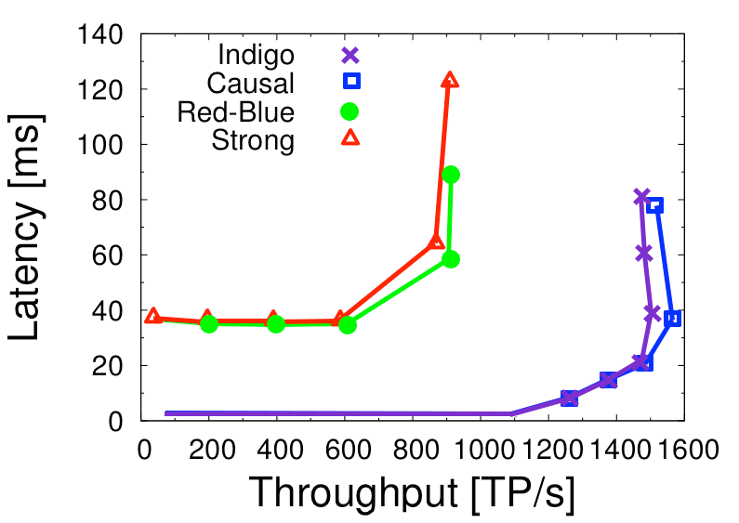
AD-SERVICE
1000 ads; 100% I-offenders

Slide 38
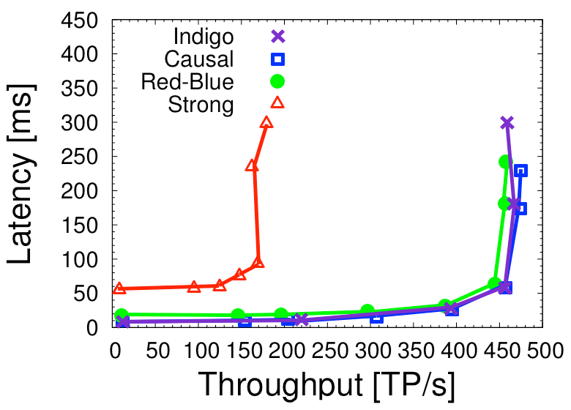
TOURNAMENT
82% reads; 4% safe writes; 14% I-offenders

Slide 39
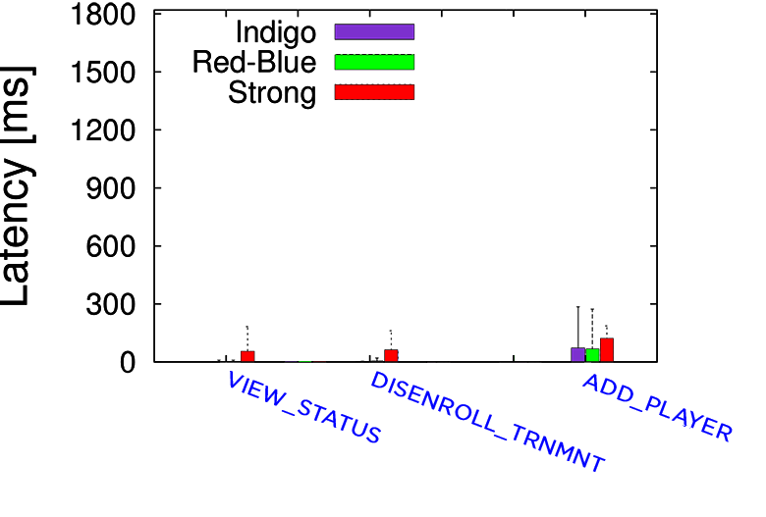
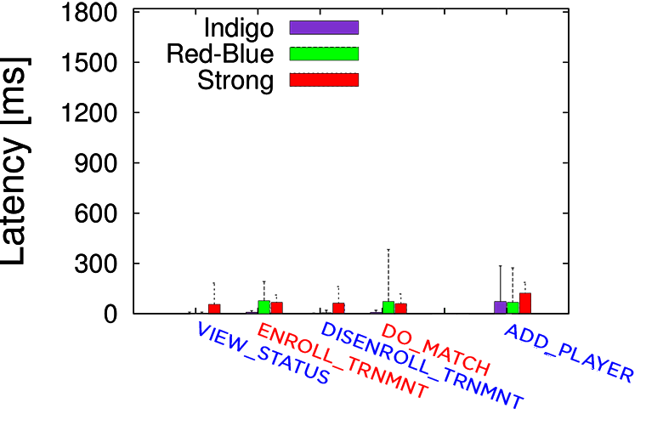
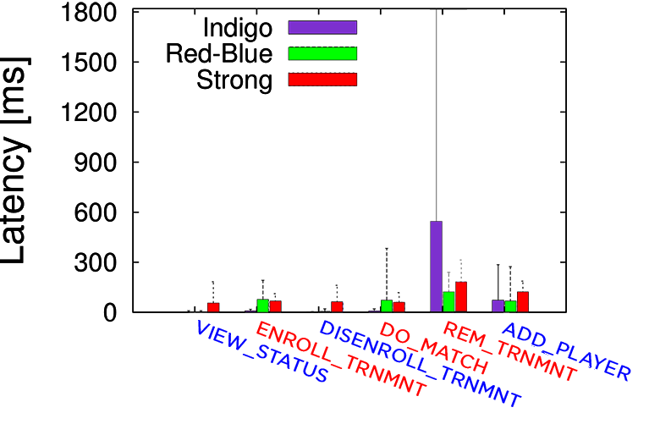
TOURNAMENT: OPERATIONS LATENCY
Detailed Operations Latency
Notes:
To understand in practice what is the latency that clients may observe

Slide 40
CONCLUSIONS
Explicit Consistency successfully reduces coordination:
  Programmers provide simple annotations;
  Static analysis detects conflicting operations;
  Low-latency operations with reservations.
Performance comparable to Causal consistency.

Slide 41
QUESTIONS?

Slide 42
Adding more reservations

Slide 43
Latency over time

Slide 44
Overhead with increasing contention

