Slide 1
Non-Monotonic Snapshot Isolation: scalable and strong consistency for geo-replicated transactional systems
Masoud Saeida Ardekani, Université Pierre-et-Marie-Curie
Pierre Sutra, Université de Neuchâtel
Marc Shapiro, INRIA & Université Pierre-et-Marie-Curie

Slide 2
Motivation
x
Geo-replication for
Low latency
Availability
Disaster tolerance
x
y
y
Requirements
Transaction
Strong consistency: No concurrent writes to the same object
Progress: if no conflict then commit
Notes:
Let me start by briefly explaining the motivation and requirements of this work.
Geo-replication is crucial for cloud applications in order to ensure low latency/availablity/ and disaster tolerance.
Geo-replication
Transactional support

Slide 3
Consistency Hierarchy
Strict Serializability (SSER)
Snapshot Isolation (SI)
Serializability (SER)
Scalability & Performance
Easy Coding and Reasoning
Parallel Snapshot Isolation (PSI)
Update Serializability (US)
Non-Monotonic Snapshot Isolation
Read Committed

Slide 4
Desired Scalability Properties
Wait-Free Queries
Queries do not wait or abort
Minimal Commitment Synchronization
Synchronize only if necessary
Transaction T_{i} waits for T_{j} only if they write-write conflict
Genuine Partial Replication (next slides)
Forward Freshness (next slides)

Slide 5
Desired Scalability Properties
3. Genuine Partial Replication [Schiper’10]
Only replicas of objects read or written inside the transaction communicate
Non-conflicting transactions do not interfere with each other
Intrinsic parallelism of workloads can be exploited
u,v
x,y
Begin
x++;
y++;
End
x,y
Begin
Read (u)
v++;
End
u,v

Slide 6
Base Freshness Snapshots
Alice
R(x)
R(y)
1
5
x
W(1)
U.S.
y
W(5)
W(6)
W(7)
Europe
Stale Data Reads
Increased Abort Ratio
More Global Communication [Saeida’13]
Snapshot Isolation
Parallel Snapshot Isolation

Slide 7
Desired Scalability Properties
4. Forward Freshness Snapshots
try to read as recent as possible
Alice
R(x)
R(y)
1
7
x
W(1)
U.S.
y
W(5)
W(6)
W(7)
Europe

Slide 8
Objective: ensuring all four properties
 | Strict Serializability | Serializability | Update Serializability | Snapshot Isolation | Parallel Snapshot Isolation
Wait-free Queries | ✔ | ✔ | ✔ | ✔ | ✔
Genuine Partial Rep. |  |  | ✔
Forw. Freshness Snap. | ✔ | ✔ | ✔
Minimum Comm. Sync. |  |  |  | ✔ | ✔

Slide 9
Our solution: Non-Monotonic Snapshot Isolation (NMSI)
 | Strict Serializability | Serializability | Update Serializability | Snapshot Isolation | Parallel Snapshot Isolation | NMSI
Wait-free Queries | ✔ | ✔ | ✔ | ✔ | ✔ | ✔
Genuine Partial Rep. |  |  | ✔ |  |  | ✔
Forw. Freshness Snap. | ✔ | ✔ | ✔ |  |  | ✔
Minimum Comm. Sync. |  |  |  | ✔ | ✔ | ✔

Slide 10
Non-Monotonic Snapshot Isolation
Read committed values
Take consistent snapshots
T₁
T₂
x
x
W(1)
W(1)
R(1)
W(1)
W(2)
y
y
T₁

Slide 11
Non-Monotonic Snapshot Isolation
Read committed values
Take consistent snapshots
During commit time
Always commit queries
Commit update transaction if no concurrent write-conflicting transaction
Forward Freshness
Wait-Free Queries
Minimal Commitment Sync & Genuine Partial Replication

Slide 12
Consistency Hierarchy
Strict Serializability (SSER)
Snapshot Isolation (SI)
Serializability (SER)
Scalability & Performance
Easy Coding and Reasoning
Parallel Snapshot Isolation (PSI)
Update Serializability (US)
Non-Monotonic Snapshot Isolation
Read Committed

Slide 13
Anomalies
Write Skew
Two concurrent transactions do not observe update of each other
Easy to solve [Cahill’08]
Pack each invariant into an object
Read (x)
Read (y)
If (x+y) > 0
Write (x,-15)
x=10
x=-5
Invariant: x+y > 0
y=10
y=-5
Read (x)
Read (y)
If (x+y) > 0
Write (y,-15)
y=10

Slide 14
Anomalies
Real-time Violation
Observe the effect of a transaction, but not all transactions preceding it in real time
Observable in Parallel Snapshot Isolation and Serializability
T₁
W(1)
x
y
W(2)
T₂

Slide 15
Anomalies
Non-Monotonic Snapshots
Avoidable in case of one client
Observable in Parallel Snapshot Isolation
T₁
W(1)
x
y
W(2)
T₂

Slide 16
Anomalies
 | Strict Serializability | Serializability | Update Serializability | Snapshot Isolation | Parallel Snapshot Isolation | NMSI
Write Skew |  |  |  | Observable | Observable | Observable
Real-Time Violation |  | Observable | Observable |  | Observable | Observable
Non-Monotonic Snapshots |  |  | Observable |  | Observable | Observable

Slide 17
Our Protocol
Execution Phase
Execute reads using Dependence Vector
Compute updates
Termination Phase
Propagate update transactions using Atomic Multicast
Certify update transactions
Execution
Termination
Propagate
Certify
Notes:
Dependence Vector: used to take consistency snapshots while ensuring forward freshness

Slide 18
Our Protocol
Ensure Wait-free Queries
Ensure Forward Freshness
x+=1
y+=1
Commit
R(x)
R(y)
Commit
Bob
in U.S.
Deliver & Certify
1
7
x
W(1)
Atomic
Multicast
U.S.
y
W(5)
W(6)
W(7)
Europe
Ensure
Genuineness &
Min. Comm. Sync.
z
W(2)
Asia

Slide 19
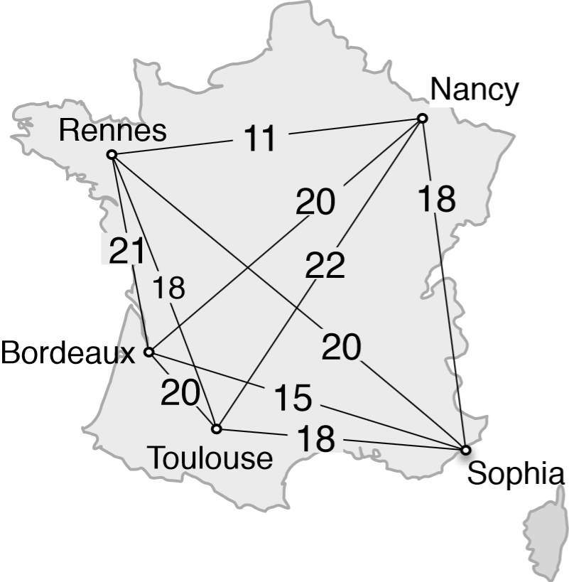
Evaluation Setup
5 Sites in Grid’5000
A group of 3 replicas in each site
Clients distributed uniformly among sites
Modified YCSB benchmark [Cooper’10]

Slide 20
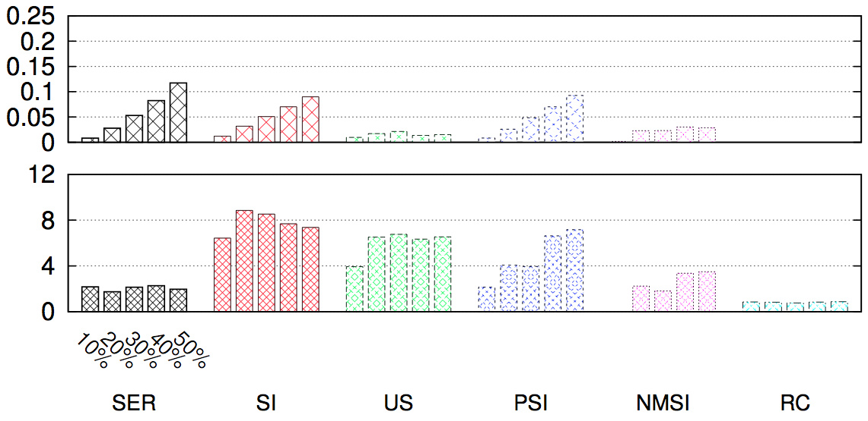
Forward Freshness & Min. Comm. Sync.
Update Transaction Abort Ratio
Commitment Synchronization Cost
4 Sites
Queries: 4 Reads
Updates: 2 Reads, 2 Updates
Notes:
Update Ratio
The lower, the better

Slide 21
Forward Freshness & Min. Comm. Sync.
Update Transaction Abort Ratio
Commitment Synchronization Cost
4 Sites
Queries: 4 Reads
Updates: 2 Reads, 2 Updates
Commitment Synchronization = Cost
Termination latency in
the experiment
Termination latency in
solo execution
Notes:
Update Ratio
The lower, the better

Slide 22
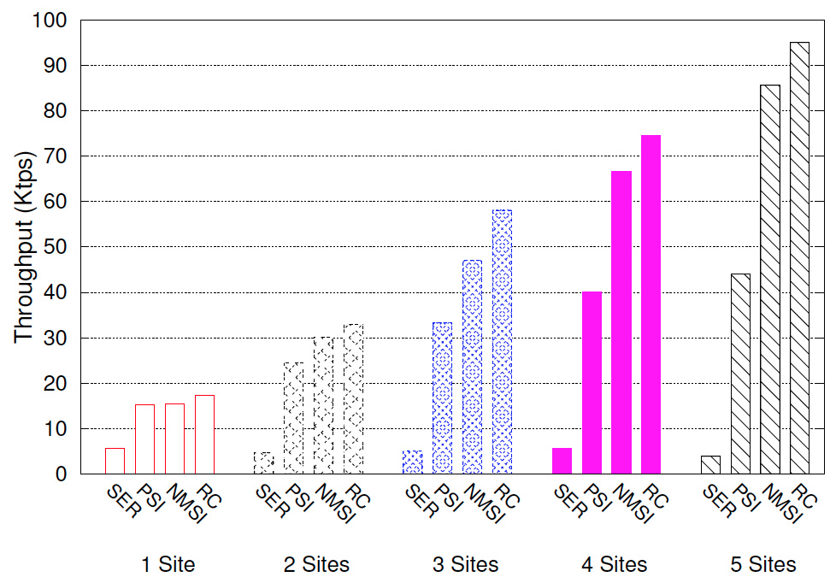
Wait-free Queries & Genuine Partial Rep.
90% Queries
10% Updates
Queries: 4 Reads
Update: 4 Reads, 1 Update
91%
71%
33%
20%
Notes:
The upper, the better

Slide 23
Conclusion
Four scalability properties:
Wait-free queries
Forward freshness
Genuine partial replication
Minimal commitment synchronization
Non-Monotonic Snapshot Isolation
Satisfying four properties
Between 2 to 14 times faster than other strong consistencies
No new anomaly compared to Parallel Snapshot Isolation

Slide 24
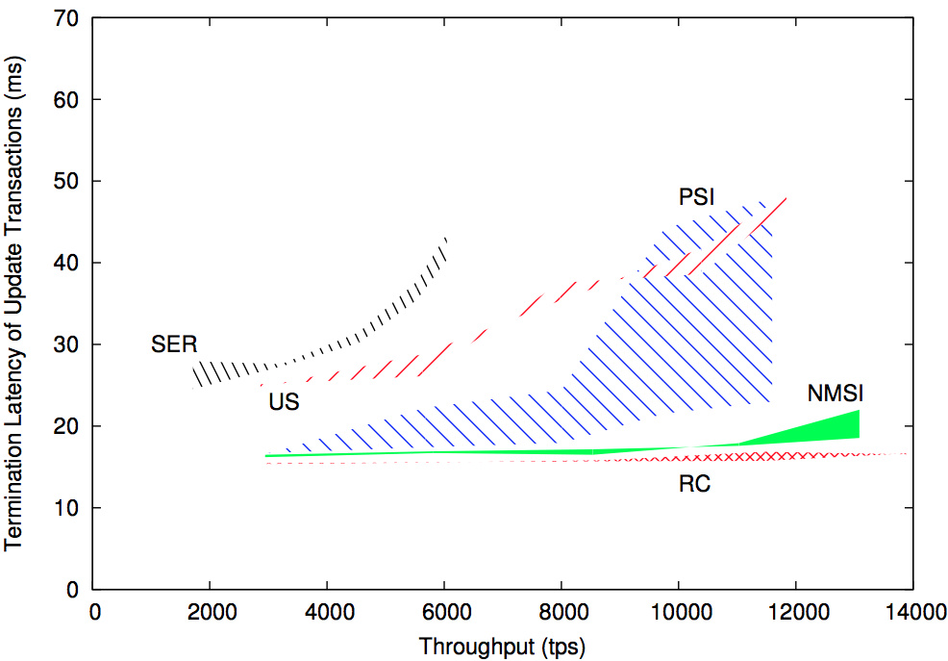
Throughput vs. Latency
4 Sites
Lower: 90% Queries, 10% Updates
Upper: 70% Queries, 30% Updates
Queries: 2 Reads
Update: 1 Reads, 1 Update

Slide 25
Genuine Partial Replication (GPR) [Schiper’10]
Full Replication
Every replica must perform all updates
Not scalable
Partial Replication
Addresses full replication issue
Protocols still rely on system-wide consensus/communication
Genuine Partial Replication
Only replicas of objects accessed or modified inside the transaction communicate with each other
Non-conflicting transactions do not interfere with each other
Intrinsic parallelism of workloads can be exploited

Slide 26
T₁
R(x)
R(y)
W(-15)
10
10
x=10
y=10
10
10
T₂
R(y)
R(x)
W(-15)

